Slide 1
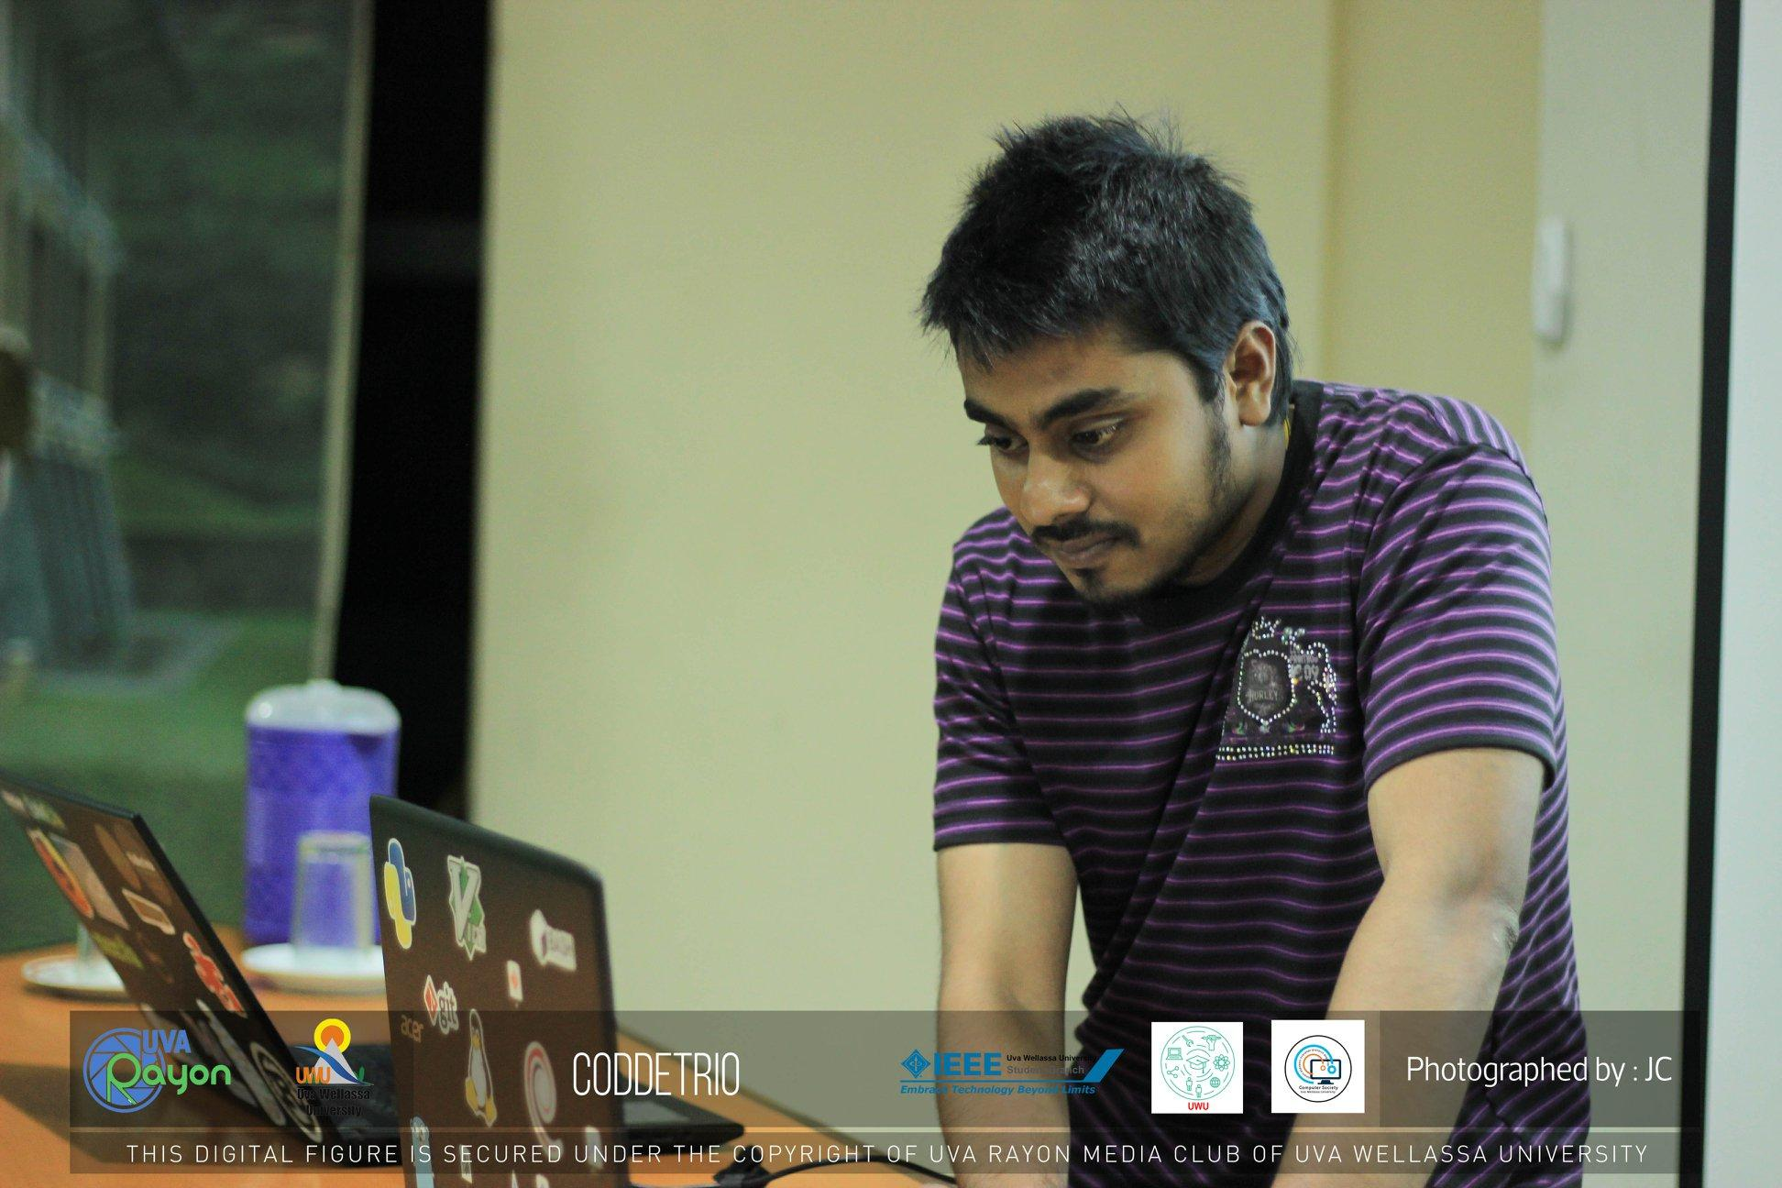
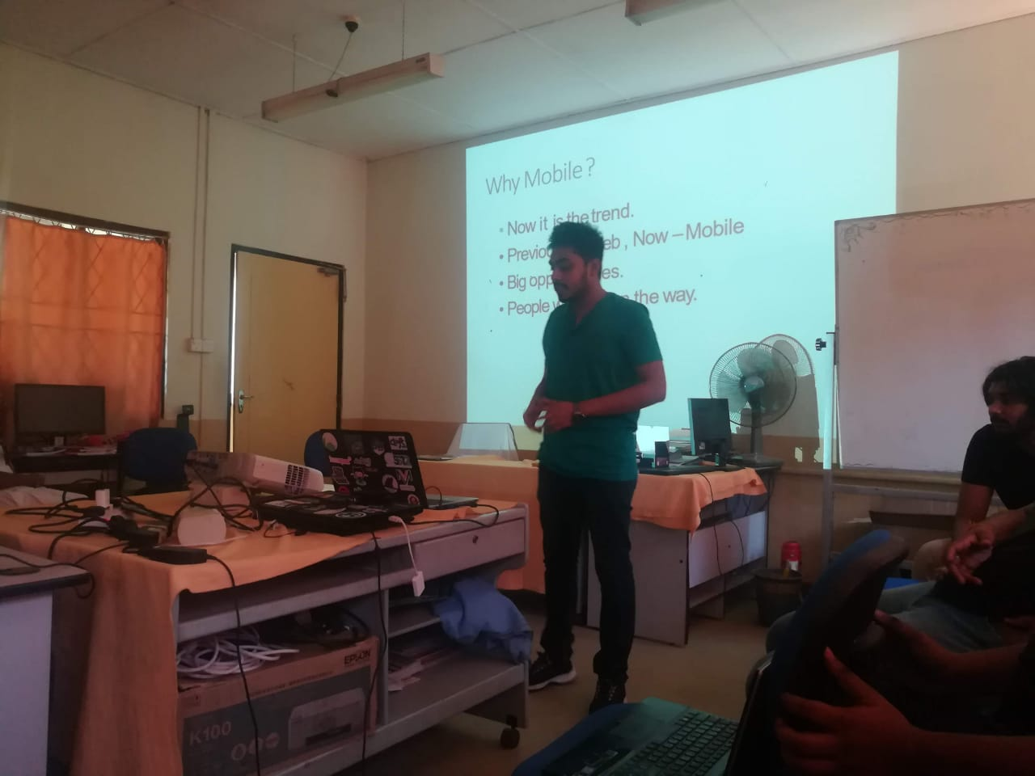
Project Portfolio
H.M.P.Praneeth.J
Bsc.Industrial Information Technology

Slide 2
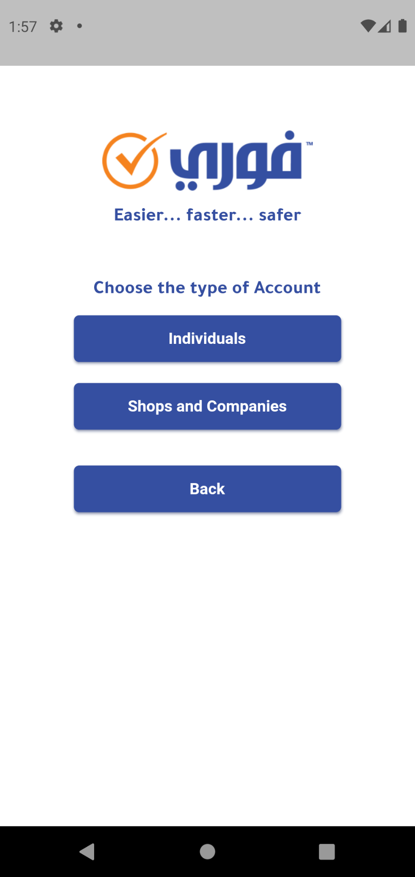
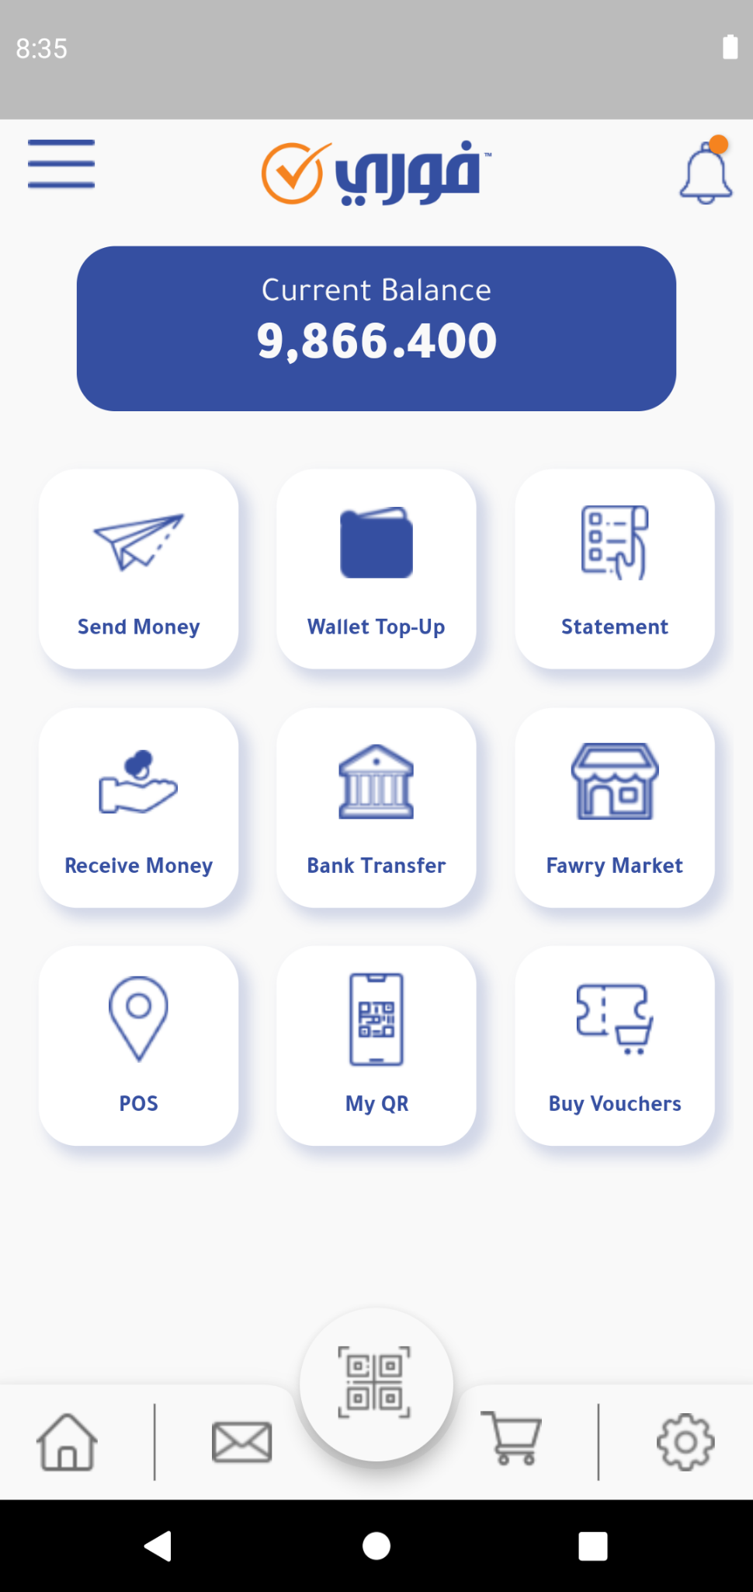
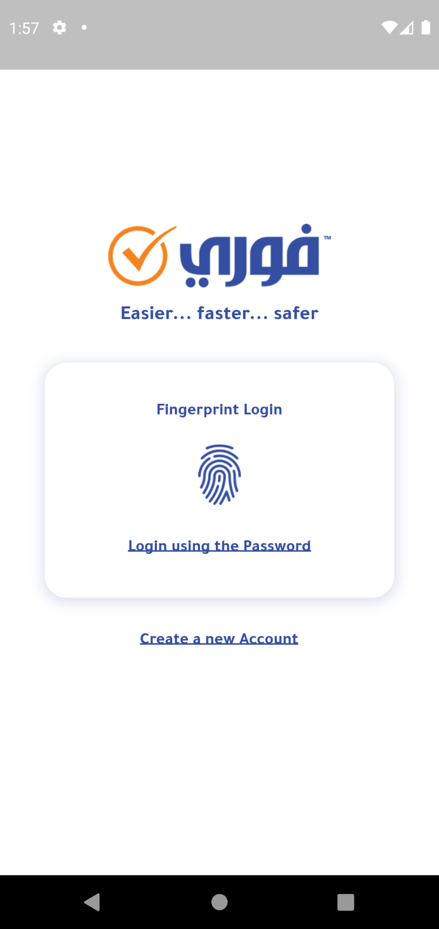
Project Name : Fawry App
2023
Used Technologies :
Flutter, Dart, Whatsapp API, BLoC, Rest API
Description : One of a financial app for managing personal account
Role: Flutter Developer
Responsibilities:
>Design and implement the app's user interface and user experience.
>Update the app according to user’s requirement.
>Connect Backend APIs.
>Test and debug the app to ensure optimal performance.
>Continuously update and maintain the app to ensure the best user experience.
>Present the currently developed modules to clients and supervisors.
App URL : Click here to view the app

Slide 3
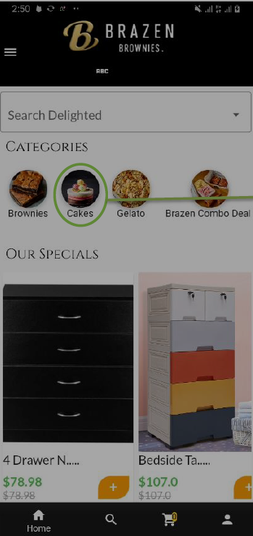
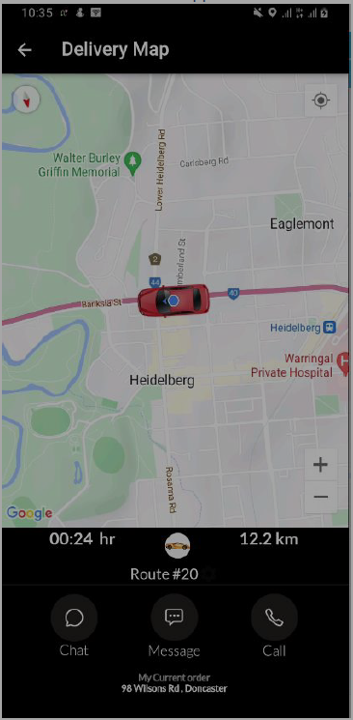
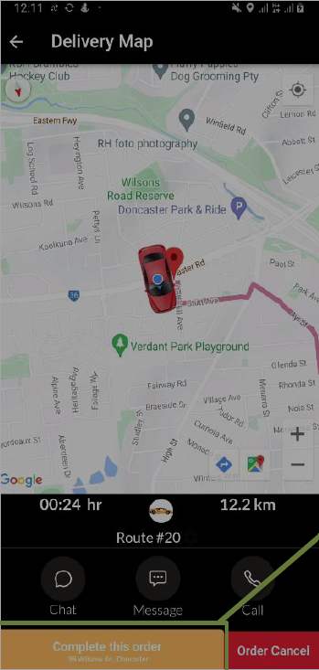
Project Name : Ecommerce and Delivery App
2022
Used Technologies :
Flutter, Dart, Google Map, SDK, Azure SignalR, GetX, Rest API
Description : An Unique Delivery Tracking and E-commerce System
Role: Full Stack Developer
Responsibilities:
>Research existing application techniques and technologies.
>Design and implement the app's user interface and user experience.
>Develop Backend APIs and deploy to Azure.
>Implement features such as virtual try-on and real-time tracking.
>Test and debug the app to ensure optimal performance.
>Continuously update and maintain the app to ensure the best user experience.
>Present the currently developed modules to clients and supervisors.
>Documentations.
All Functions : Click here to view documentation

Slide 4
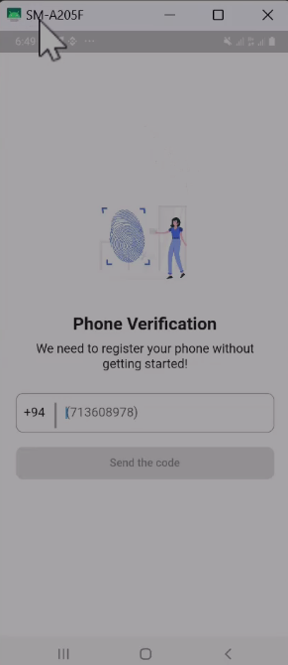
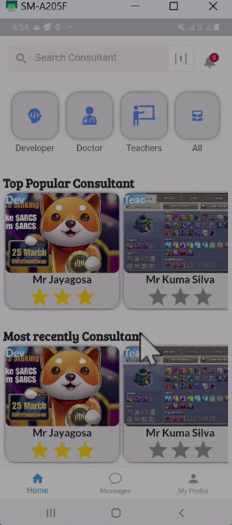
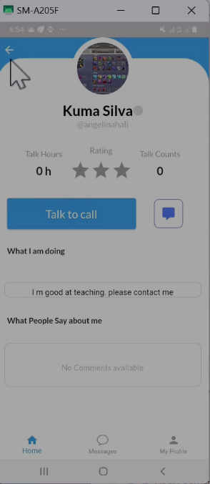
Project Name : Video Scheduling App - Time to Talk
2022
Used Technologies :
Flutter, GetX, Web Socket, Google Maps, Agora, Firebase , and PayPal
Description : A video scheduling app for meeting premium professionals online.
Role: Open source Developer
Responsibilities:
>Research UI and UX.
>Research existing application techniques and technologies.
>Develop User interfaces and functions including user authentication, appointment scheduling, and video calls, professionals' availability, with call reminders for both users and professionals,professional profile search and the ability to transition a user profile into a professional profile.
>Develop Backend APIs have been developed using Node.js.
>Test and debug the app to ensure optimal performance.
Demo : To view the app Demo, click here.
All Functions : To view the app on GitHub, click here.

Slide 5
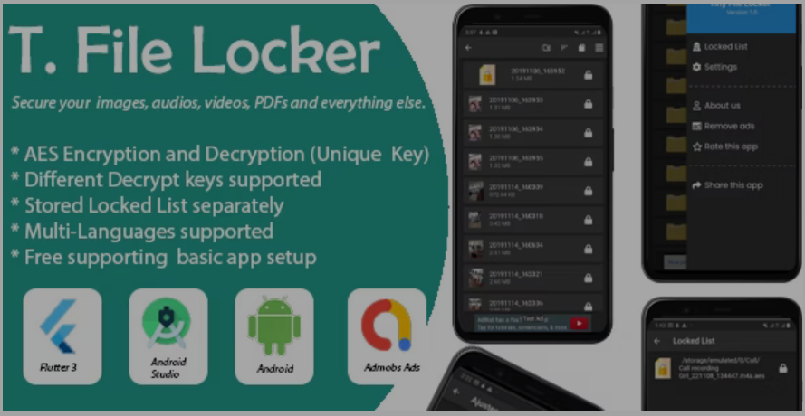
Project Name : Android File Locker
2022
Used Technologies :
Flutter, Dart core, Localization, Isolate, Material Sharedpreferences
Description : To lock users' files with multiple passcodes
Role: Flutter Developer
Responsibilities:
>Research on Flutter concurrent execute tasks.
>Study on isolate and compute
>Developed an app that support locked and unlocked there file with a preset password.
>Create Documentation.
>Released the App on Codecanyon.
>Released the App on Google Play Store.
>Test and debug the app to ensure optimal performance.
>Provide Customer Support.
Demo : To view the app Demo, click here.
All Functions : To view the app on Codecanyon, click here.

Slide 6
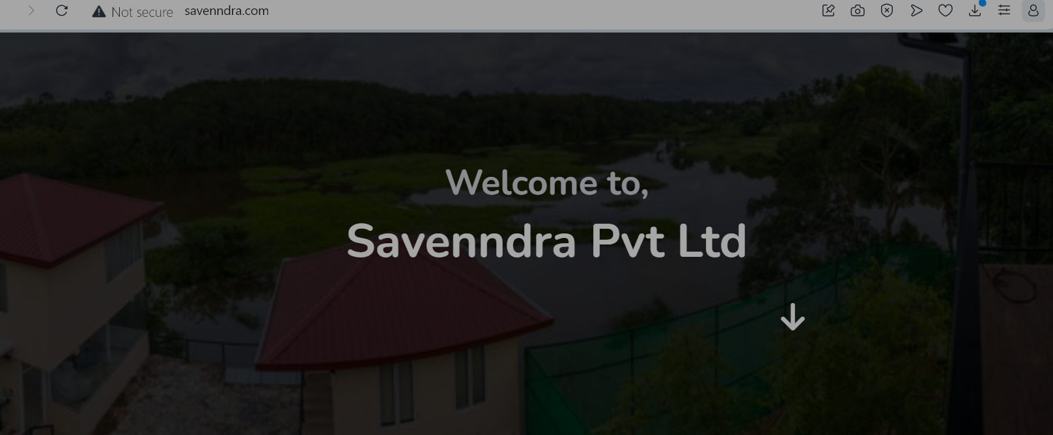
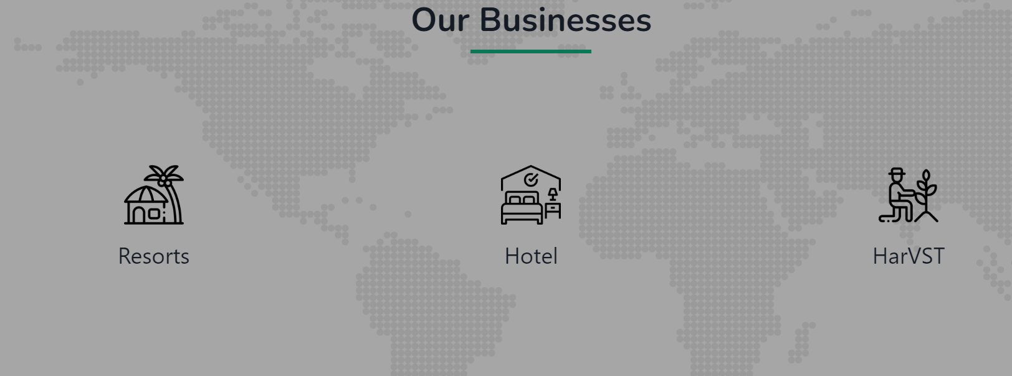
Project Name : Savenndra Web site
2021
Used Technologies :
PHP, HTML, Css, javascript and JS Animations
Description : A simple website for the “Savenndra Resort”
Role: Web Developer
Responsibilities:
>Research existing restaurant websites UI/UX.
>Design the website.
>Present the currently developed modules to clients.
Demo : To view the Website

Slide 7
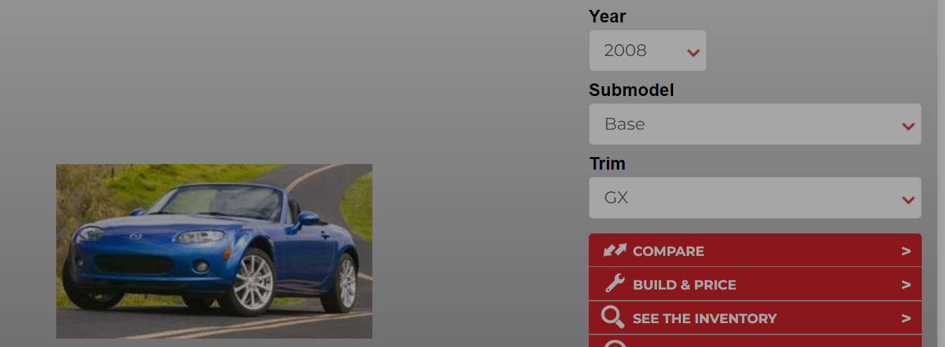
Project Name : AzVehicle project
2021
Used Technologies :
Python, Beautiful Soap, PHP, Codeigniter,css, javascript
Description : A Web scrap project to gain vehicle informations
Role: Web Developer
Responsibilities:
>Research existing web scraping techniques.
>Developed python algorithms
>Developed PHP web project
>Released the project

Slide 8
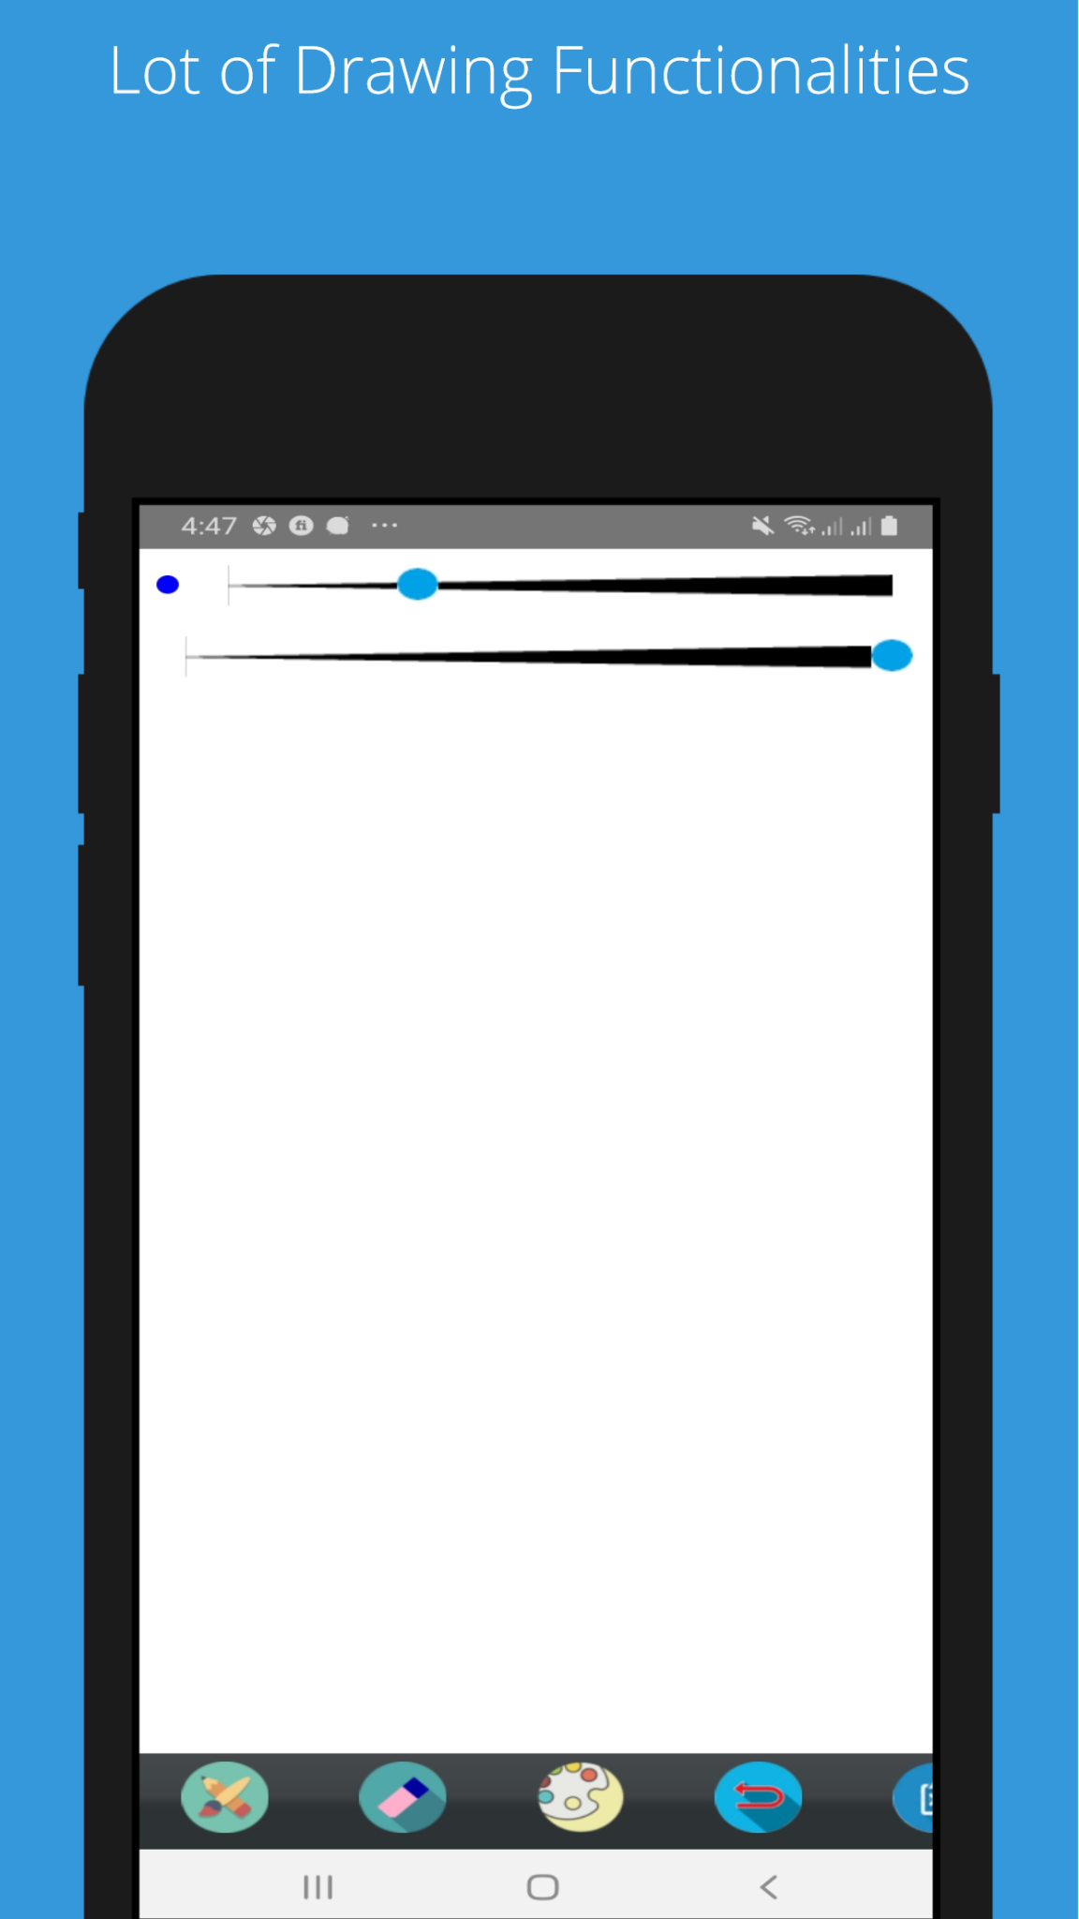
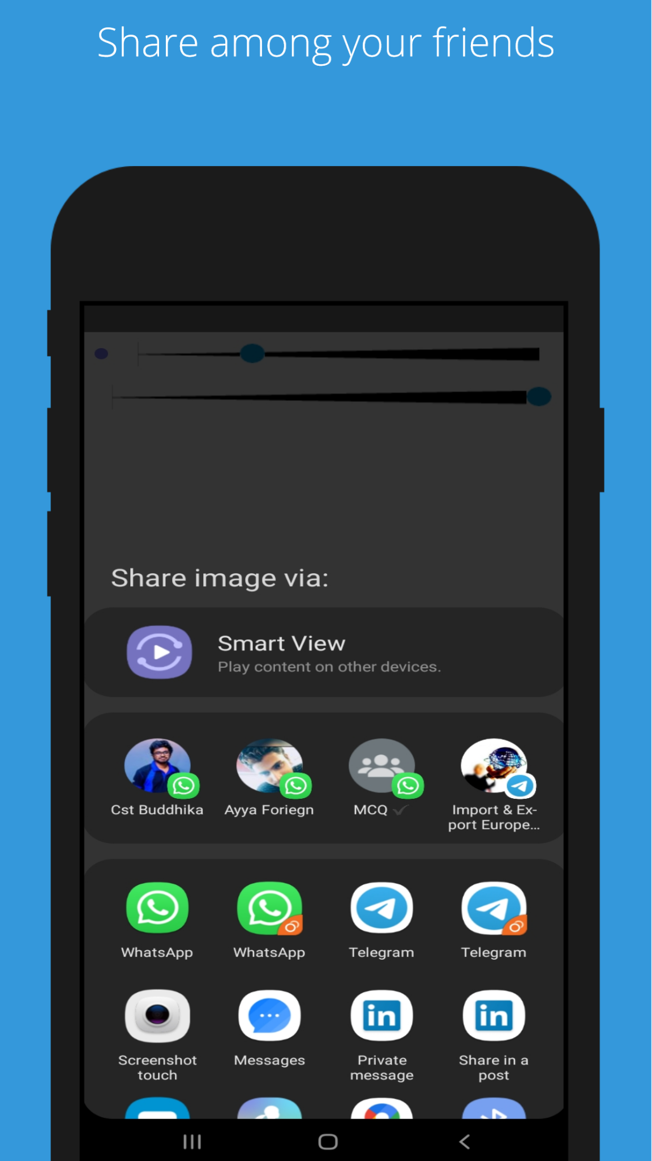
Project Name : Android paint app project
2020
Used Technologies :
Android, Kotlin
Description : A small but powerful paint app
Role: Software Developer
Responsibilities:
>Research existing paint techniques,apps and features.
>Develop a android paint app.
>Provide customer support.
>Release to play store.
>Fix bugs and releases
Demo : To view the app on the Play Store, click here.
App Source code : To view the app on GitHub, click here.

Slide 9
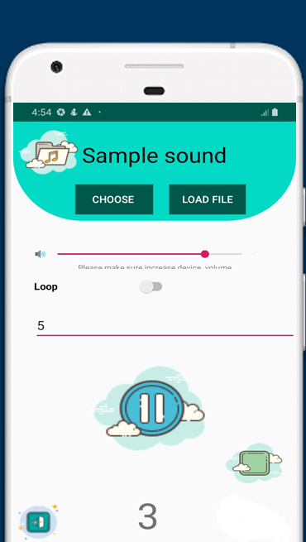
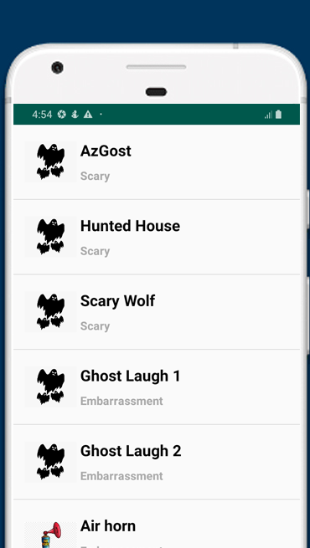
Project Name : Prank Sound App
2020
Used Technologies :
Android, Kotlin
Description : An application for playing funny sounds
Role: Software Developer
Responsibilities:
>Research existing paint techniques,apps and features.
>Develop android app
Demo : To view the app on the Play Store, click here.

Slide 10
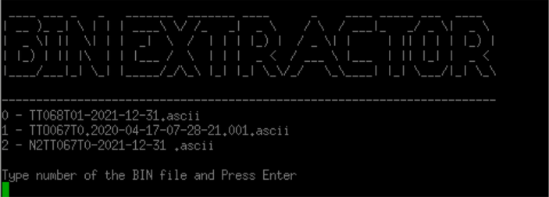
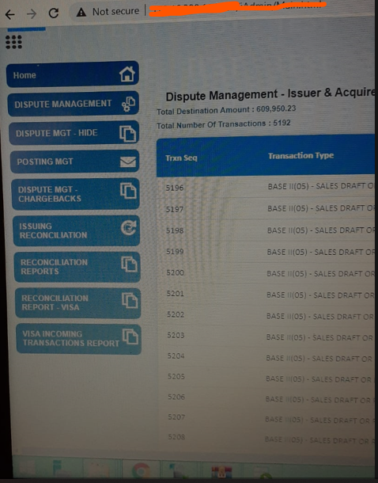
Project Name : iModules
2020/2022
Used Technologies :
Java 8, J2EE, JSP,Spring boot, Loggers, AWS, SQL, Oracle db
Description : A Financial reconciliation and Dispute module
Role: Software Engineer
Responsibilities:
>Modify existing settlement modules according to the customer
Requirements.
>Modify the modules according to Visa and mastercard mandates.
>Provide customer support for new module implementation and documentation, as
well as review customer issue tickets and provide solutions.
Demo : To view the projects handover documentations

Slide 11
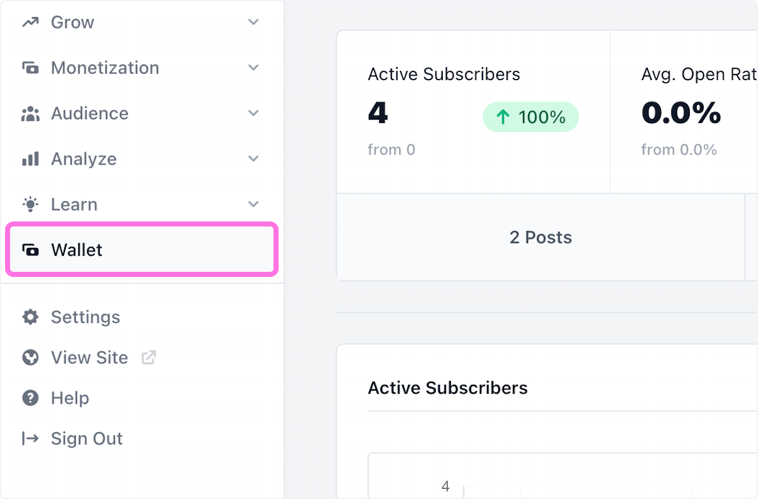
Project Name : Apigateway
2019
Used Technologies :
Java 8, Spring boot, SQL, Junit, Mockito
Description : Business to Business application for api management
Role: Internal Software Engineer
Responsibilities:
>Bug fixing.
>Customer support.
>Migrate Carbon XML modules to Spring boot.
>Testing
Demo : To view the projects handover documentations

Slide 12
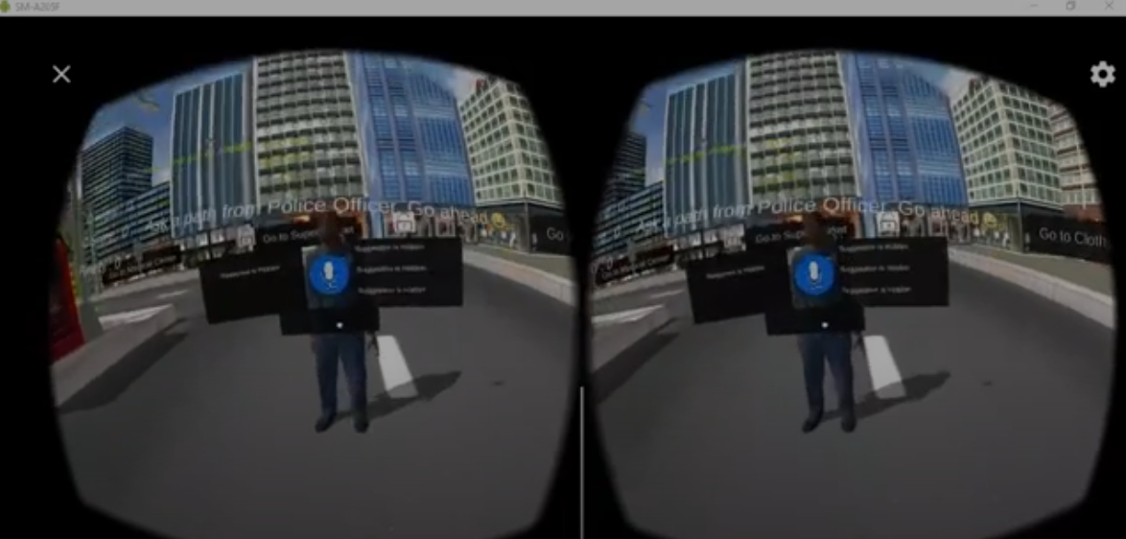
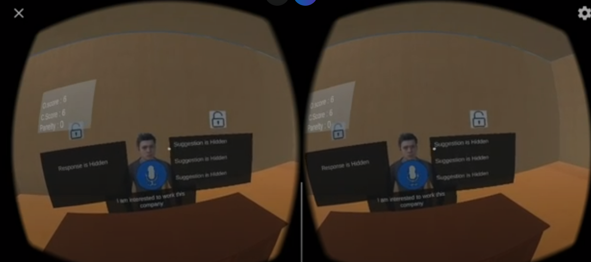
Project Name : Voice control 3D Game
2019
Used Technologies :
Unity 3D, C#, Android
Description : This is my final year research that proved that interaction with game characters is possible through voice.
Role: Researcher
Responsibilities:
>Research on available researches and applications.
>Develop 3D game.
>Proofs of how to interact game character using voice.
>Write research thesis.
>Present to the research panel.
Demo : To view the demo

Slide 13
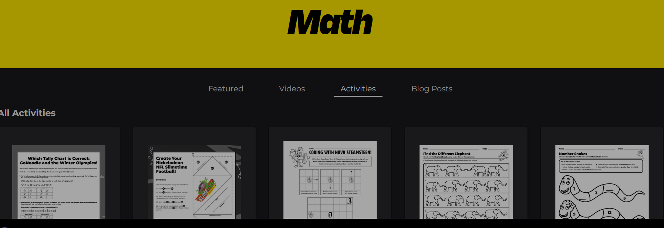
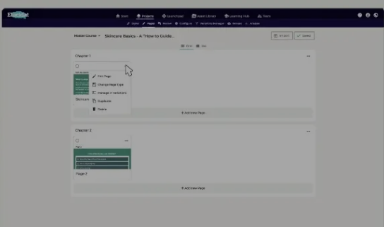
Project Name : ENode web app
2020
Used Technologies :
Java, Spring Boot, React
Js, Redux tool kit, Mongo DB, Design patterns, JUnit 5, Logger, and MySQL.
Description : Develop a B2B Stream Education platform for remote learners.
Role: Junior Software Engineer
Responsibilities:
>Develop Frontend
>Develop a B2B Stream Education platform for remote learners.
>Develop a Spring Boot microservice for notifications, utilizing AWS SNS and SQS.
>Create an AWS Lambda function to support MailChimp using Python.
>Test modules using JUnit

Slide 14
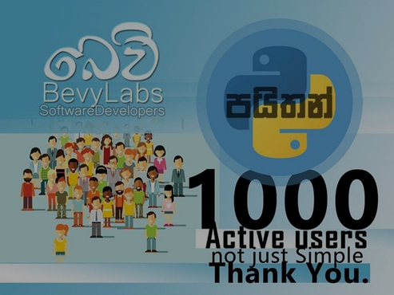
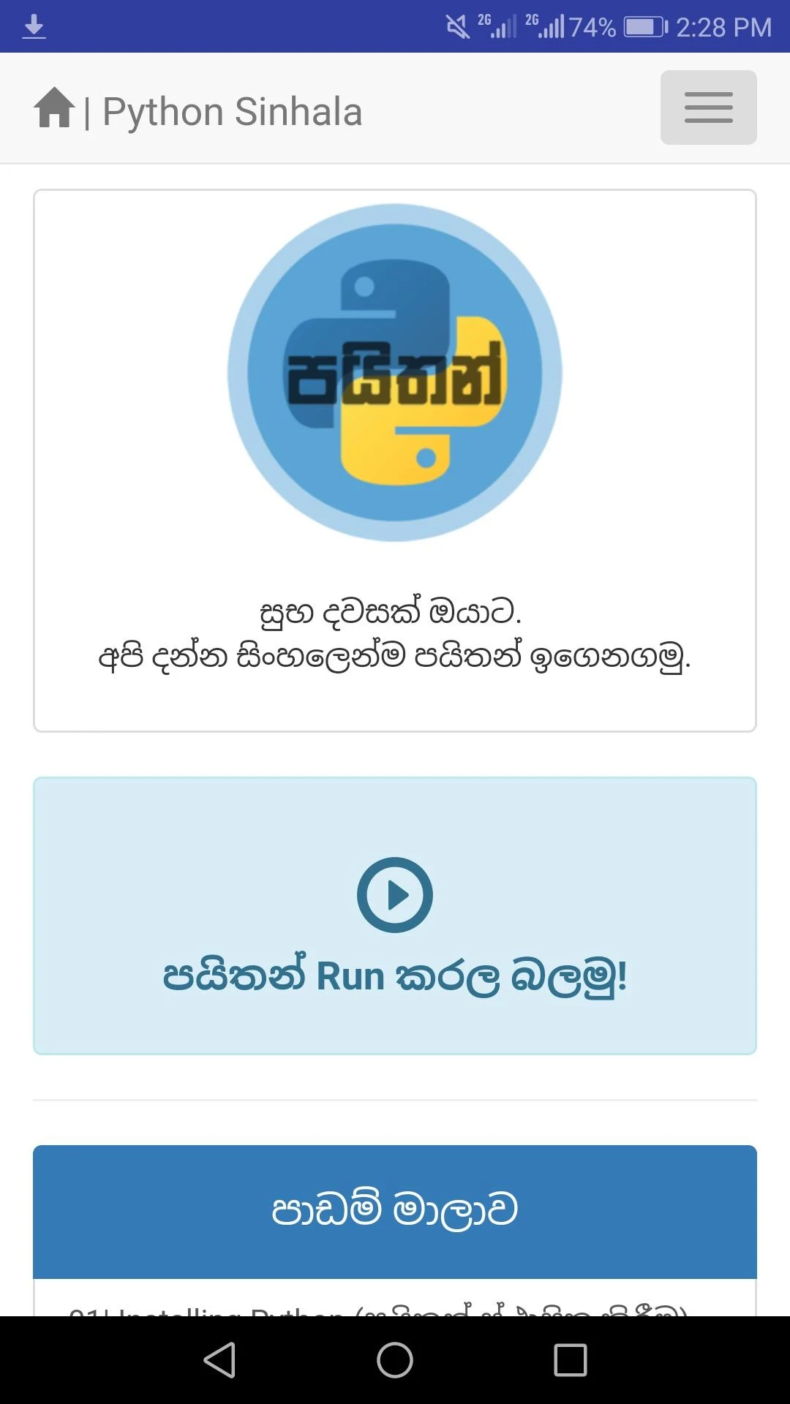
Project Name : Android,Android Studio, Java, HTML, Bootstrap
2018
Used Technologies :
Android Studio, Java, HTML, Bootstrap
Description : An android application that helps people to startup with programming. It has over 5000 downloads through the Google Playstore.
Role: Team Member
Responsibilities:
>Connect android app with webview
Demo : To view the app, Please click

Slide 15
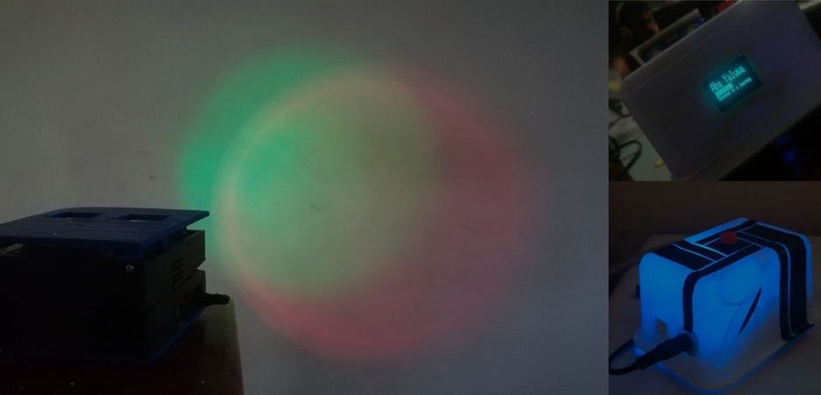
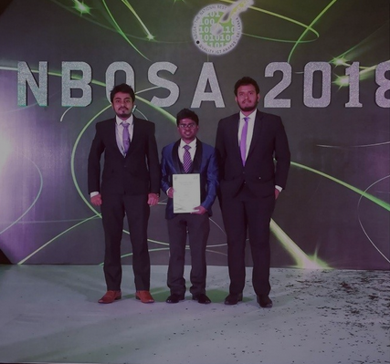
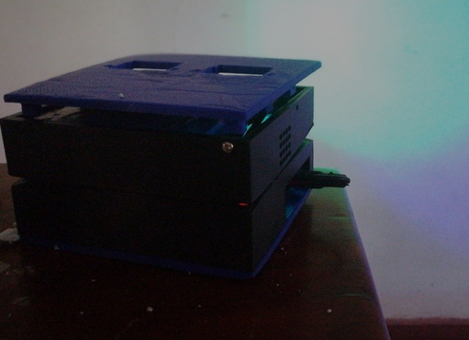
Project Name : “Amba Yaluwa” – The Concentration Device
2018
Used Technologies :
Arduino,NodeMCU, C, Electronics
Description: A concentration device that based on psychology techniques (Color psychology, Pomodoro technique)
Awards: 3rd Place (Bronze Medal) in Applied Science & Technology, "Sahasak Nimeum" National Exhibition and Competition 2018 An Exhibition Organized by Sri Lanka Inventors Commission.
Merit Award : National Best Quality ICT Awards (NBQSA) 2018 Organized by British Computer Society (BCS) - The Chartered Institute for IT.
Finalist IEEE SS12 MakerFair South Asian Exhibition and Competition 2018 An innovations exhibition Organized by IEEE
What I learnt : Believing the ideas, psychology techniques, prototyping, improving the version of an hardware project, 3D printing, working with interrupts in micro controllers.
Demo : To view the app, Please click

Slide 16
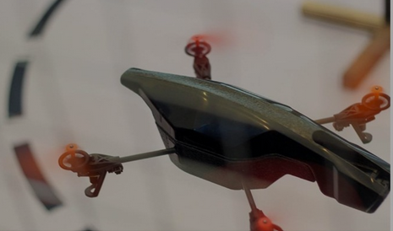
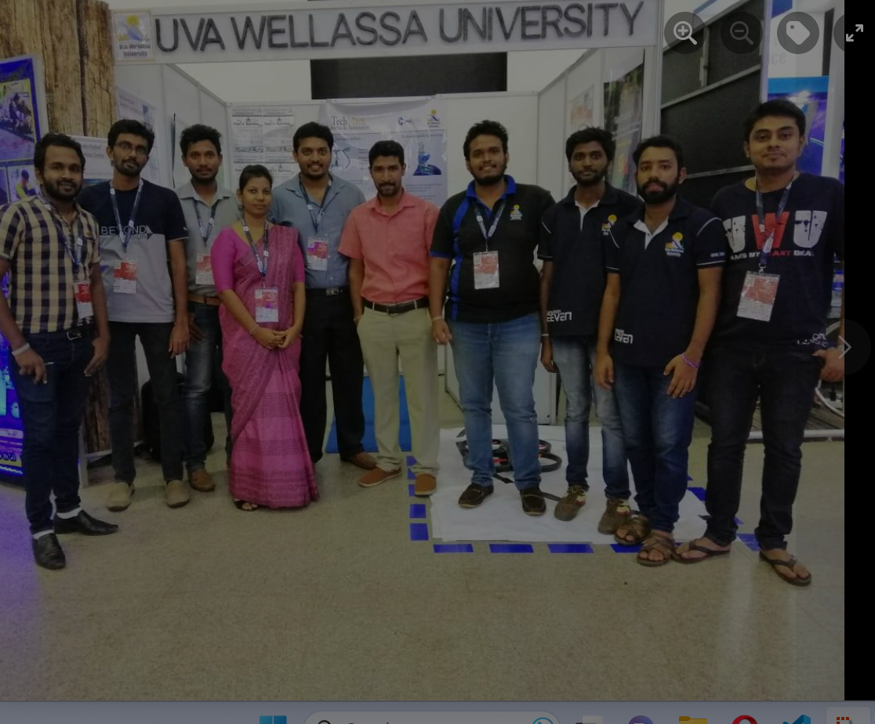
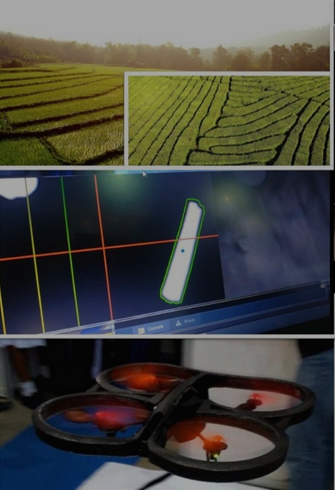
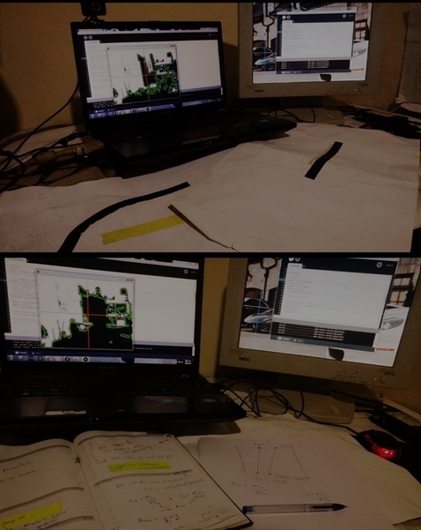
Project Name : Bevy Labs Fly Bee
2018
﻿Used Technologies: Linux kernel, Python, OpenCV, Processing
Description: An autonomous drone that can fly using detecting lines.
What I learnt : Improved dedicated mindset for achieve goals. improved team working skills,
Research on OpenCV and exists flying projects.

Slide 17
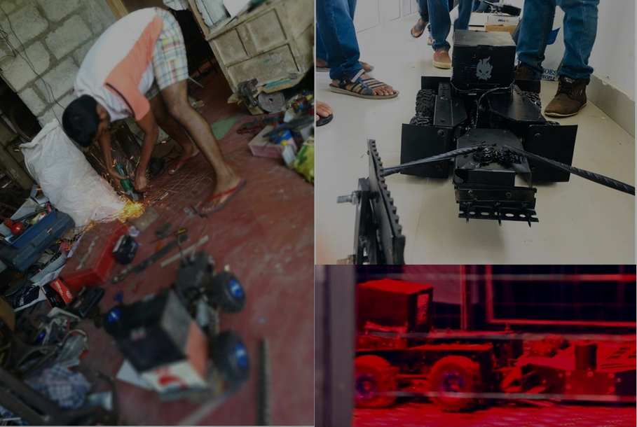
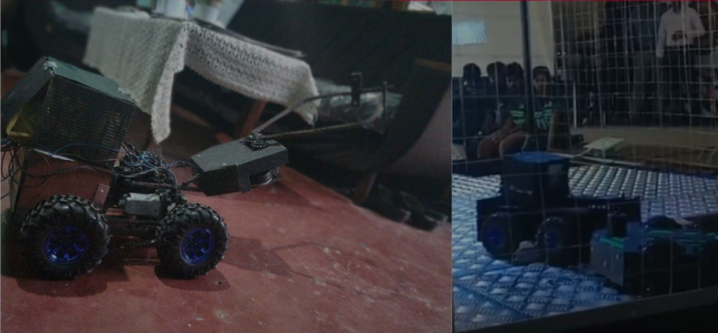
Project Name : Blacky
2017
﻿
Used Technologies: Arduino, heavy motor controlling, working with remote controllers
Description: Battle robot that can push heavy weight and damage opponents.
What I learnt :Improved critical thinking, team work skills.

Slide 18
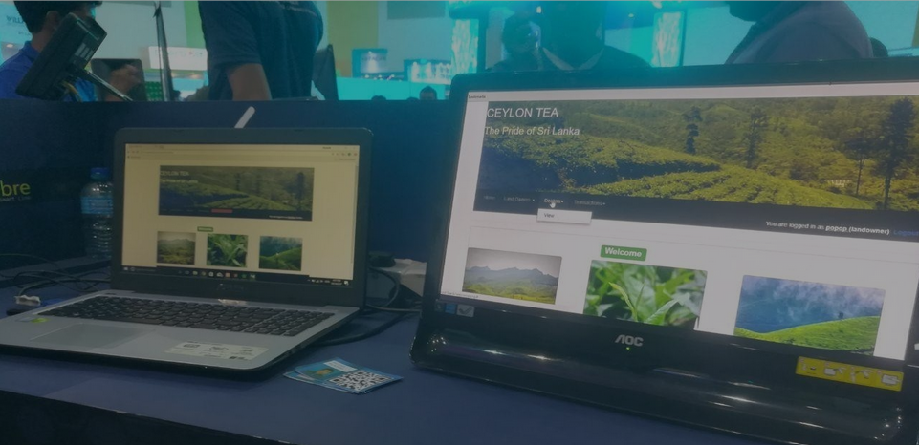
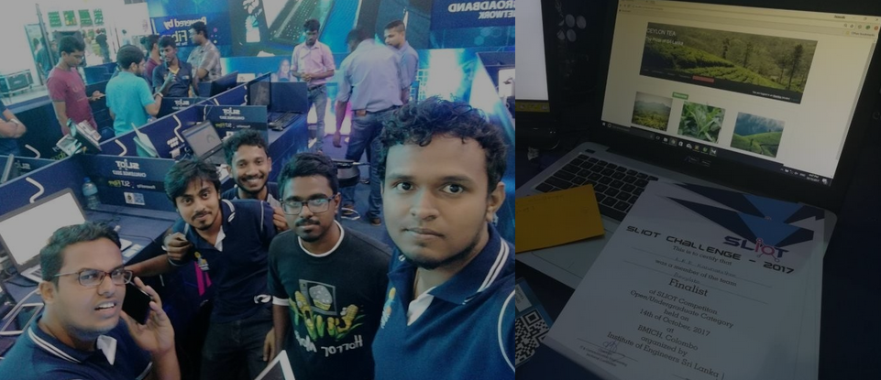
Project Name : TeaCollect++
2017
﻿
Used Technologies: Php, MySQL, QR reader
Description: New concept for tea collecting process in Sri lanka.This system provides various solutions for problems in manual tea collecting process.
Awards: Finalist in SLTIOT(Sri lanka Telecome) Challenge 2017 / Finalist in iHack 2.0
20
What I learnt: Field visits to gather requirements for different user roles, Improving Uls for better user experiences that relates to different user audiences

Slide 19
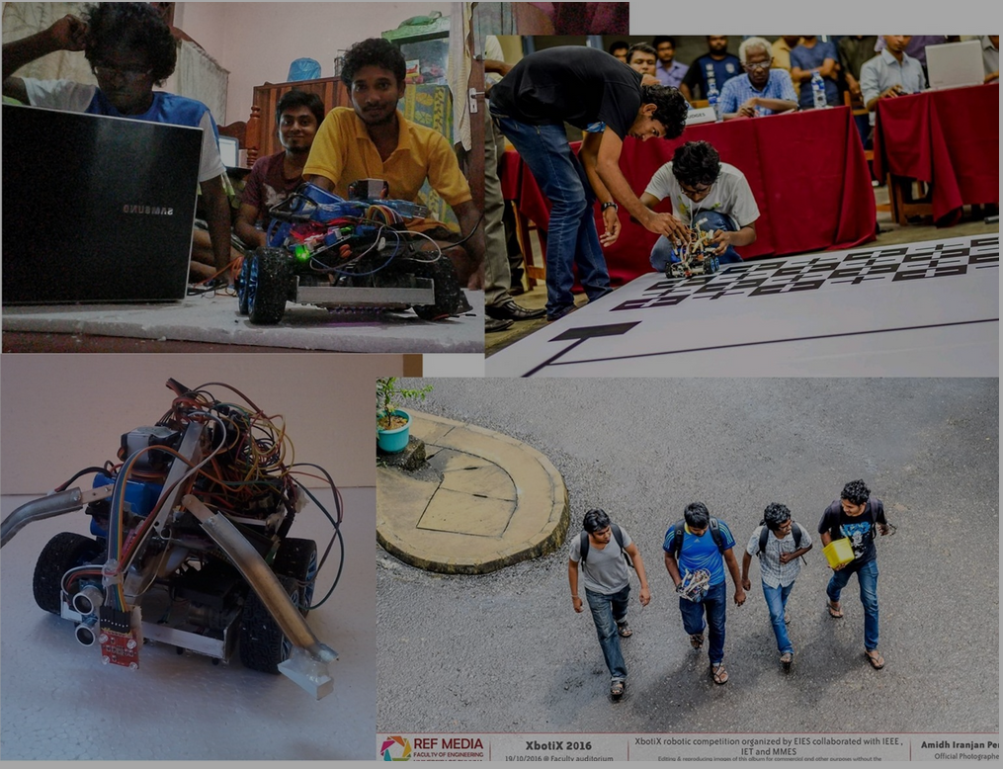
Project Name : Robot SilverTips
2016
﻿
Used Technologies: Arduino, Sensors (Color, ultrasonic, IR)
Description: This robot is designed for grab objects with color detection, line maze solving and going though the limited spaces.
What I learnt: Working with sensors, improved problem solving knowledge, team work, learnt to convert ideas into codes, working with limited time schedules.
Awards: 5th place of Xboticx 2016 A task based Robotics Competition organized by Faculty of Engineering, University of Ruhuna.

Slide 20
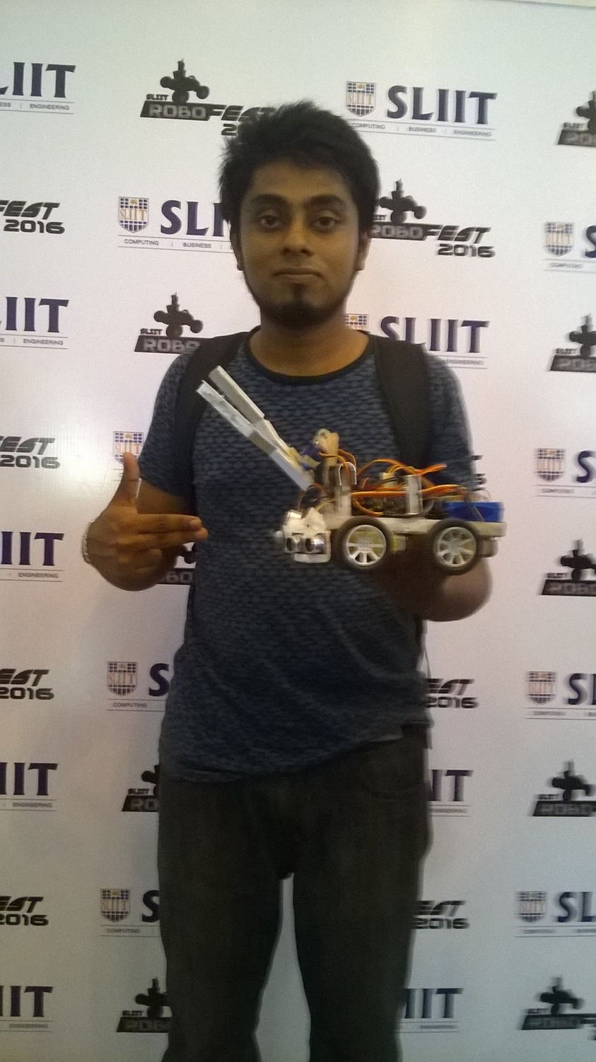
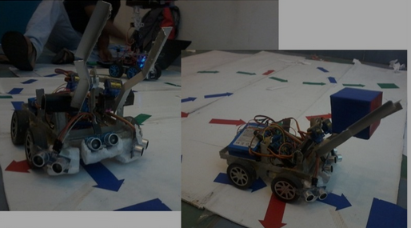
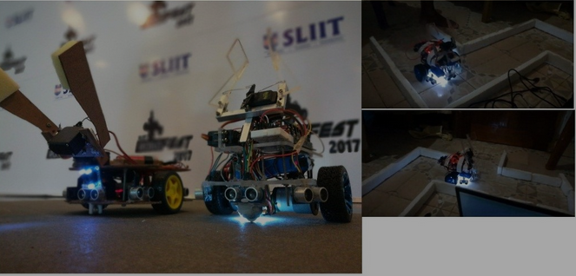
Project Name : Maze-Solving Robot
2016
Used Technologies: Arduino, Sensors (Color, ultrasonic), Maze Solving algorithms Description: This robot is designed for grab objects with color detection, wall maze solving and going though the limited spaces.
What I learnt: Working with sensors, improved problem solving knowledge, team work, learnt to convert ideas into codes, working with limited time schedules.

Slide 21
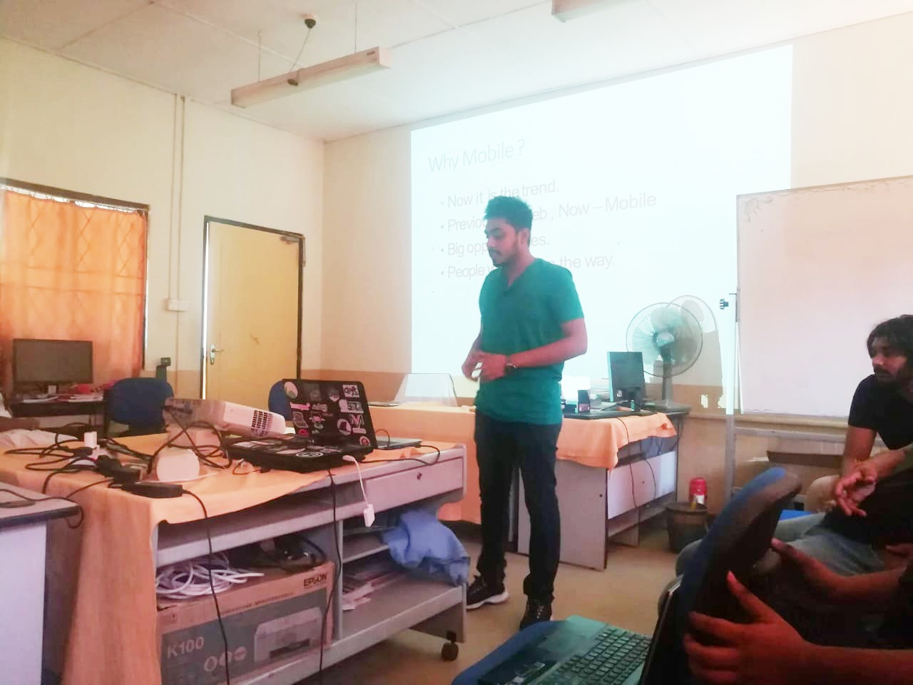
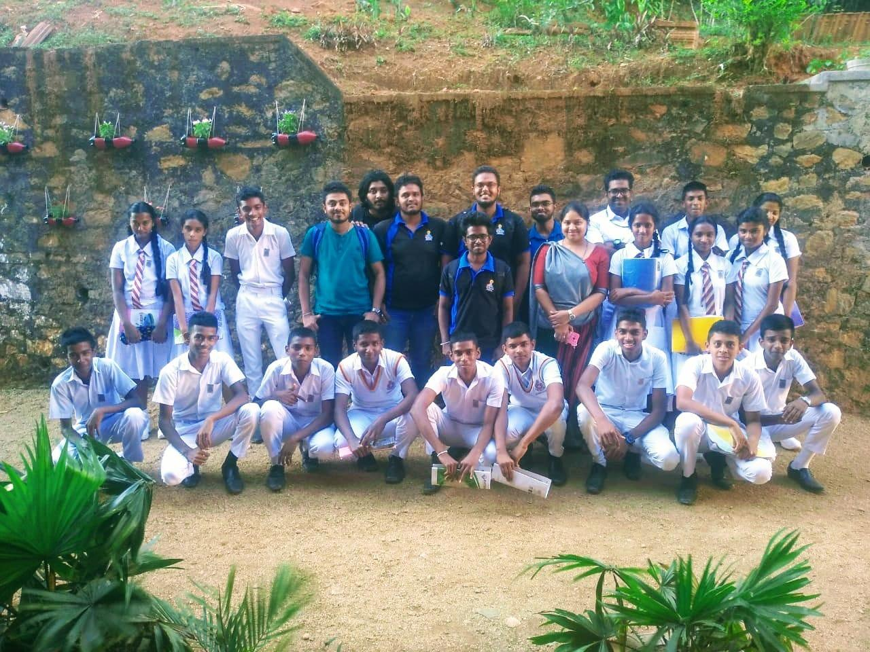
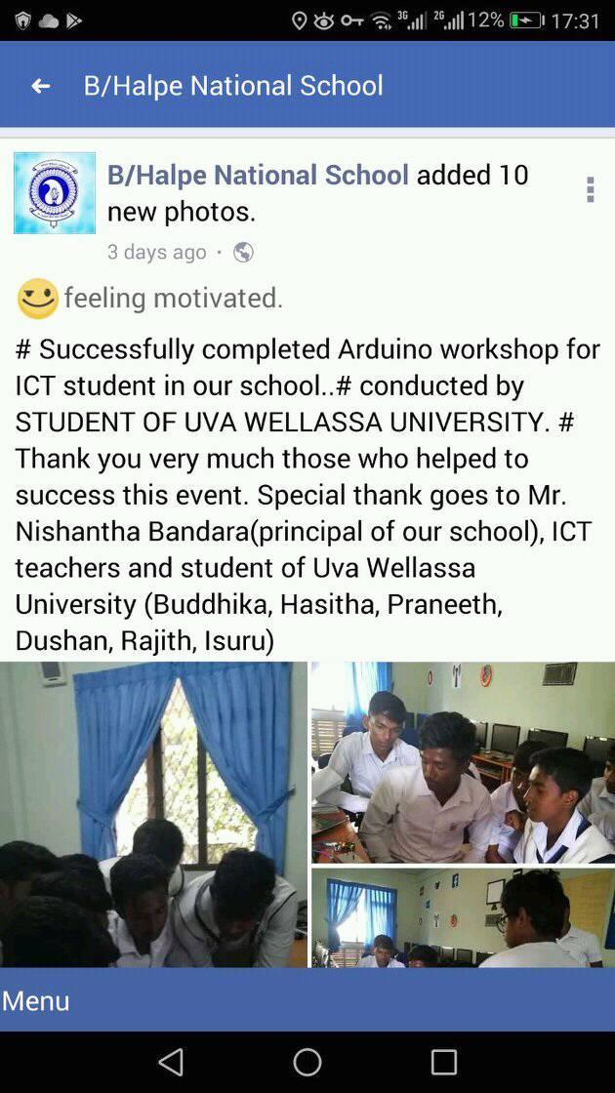
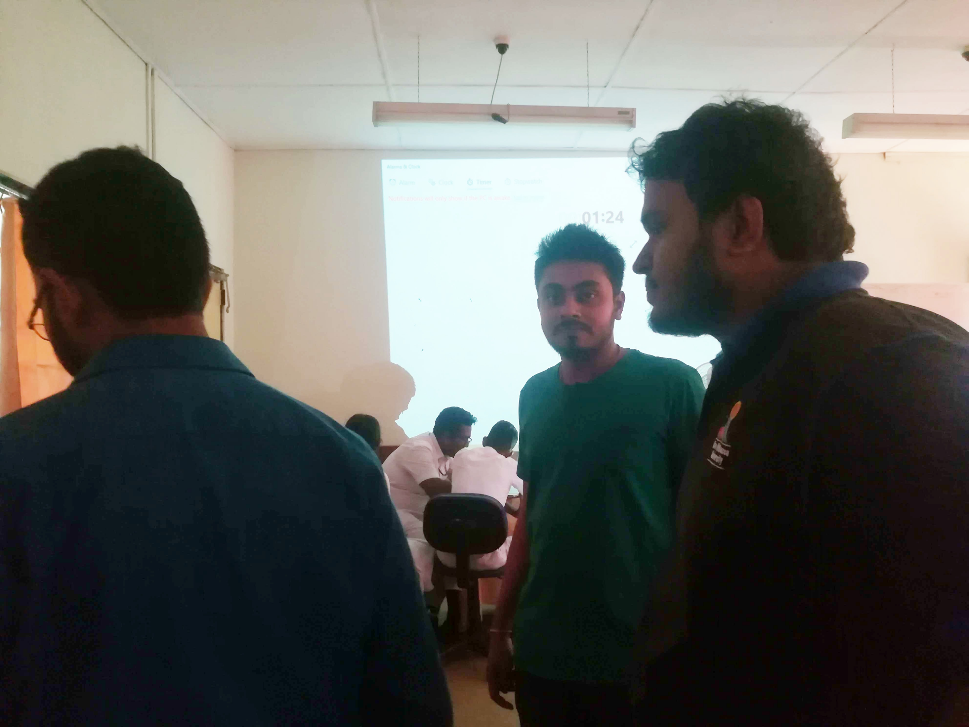
As a resource person for workshops
2016
We conducted several workshops on preparing for robotics competitions and hosted some motivational sessions to inspire the students to achieve their goals. Additionally, we received a lot of positive feedback on our workshops

Slide 22
As a resource person for workshops
2016
We conducted several workshops on preparing for robotics competitions and hosted some motivational sessions to inspire the students to achieve their goals. Additionally, we received a lot of positive feedback on our workshops

Slide 23
Newspaper Articles

